Slide 1
Introduction To Programming

Slide 2
Content
Pointer
NULL Pointer

Slide 3
Pointer
A pointer is a variable whose value is a memory address.
A pointer is a variable that stores the memory address of another variable.
Declaration of pointer-
Data_type *Variable_name;
int *p;
char *a;

Slide 4
Pointer...
&-- Symbol is used to get the address of the variable.
*-- Symbol is used to get the value of the variable that the pointer is pointing to.
Example---
int a=6;
int *p;
p= &a;
cout<< a<<"\n";
cout<< &a<<"\n";
cout<< p<<"\n";
cout<< *p<<"\n";

Slide 5


Pointer...
int number=30; int ∗ p; p=&number; //stores the address of number variable cout<<"Address of number variable is:"<<&number<<endl; cout<<"Address of p variable is:"<<p<<endl; cout<<"Value of p variable is:"<<*p<<endl;
int a=20,b=10,∗p1=&a,∗p2=&b; cout<<"Before swap: ∗p1="<<∗p1<<" ∗p2="<<∗p2<<endl; ∗p1=∗p1 + ∗p2; ∗p2=∗p1 - ∗p2; ∗p1=∗p1 - ∗p2; cout<<"After swap: ∗p1="<<∗p1<<" ∗p2="<<∗p2<<endl;

Slide 6
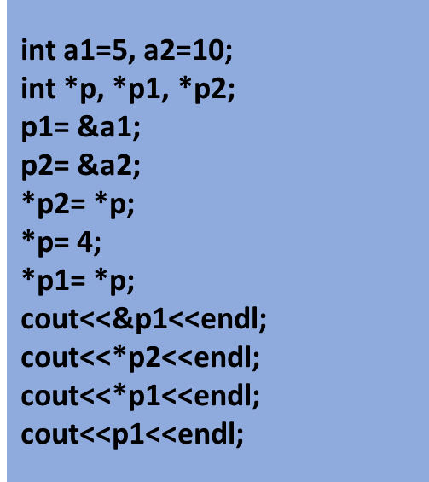
Pointer...
int a1=5, a2=10, add;
int *p1, *p2;
p1= &a1;
p2= &a2;
add = *p1 + *p2;
cout<<"Addition is: "<<add;

Slide 7
NULL Pointer
A null pointer is a special pointer value that is known not to point anywhere.
int main()
{
int *p = NULL;
cout << "The value of pointer is " << p ;
return 0;
}

Slide 8
Pointer...
C++ allows us to allocate the memory of a variable or an array in run time. This is known as dynamic memory allocation.
In C++, we need to deallocate the dynamically allocated memory manually after we have no use for the variable.
We can allocate and then deallocate memory dynamically using the new and delete operators respectively.
The new operator allocates memory to a variable.
Syntax-
pointerVariable = new dataType;

Slide 9
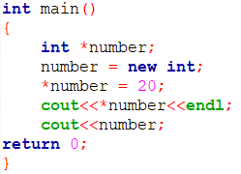
Pointer...
Here, we have dynamically allocated memory for an int variable using the new operator.
Notice that we have used the pointer number to allocate the memory dynamically. This is because the new operator returns the address of the memory location.

Slide 10
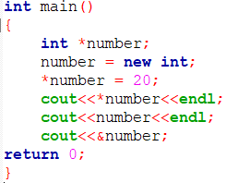

Pointer...

Slide 11
Pointer...
Once we no longer need to use a variable that we have declared dynamically, we can deallocate the memory occupied by the variable.
For this, the delete operator is used. It returns the memory to the operating system. This is known as memory deallocation.
Syntax-
delete pointerVariable;

Slide 12
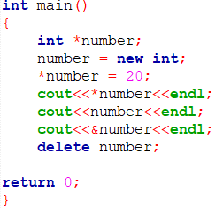
Pointer...

Slide 13
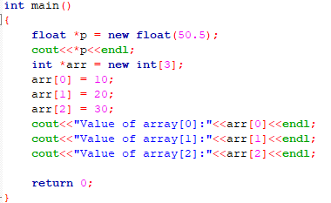

Pointer...

Slide 14
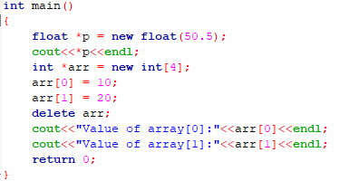

Pointer...

